Slide 1
HowTo E2E Implementation in IPB
Alexander Christoff

Slide 2
Content
Matlab/Targetlink
After Generation
C-File Adaptions

Slide 3
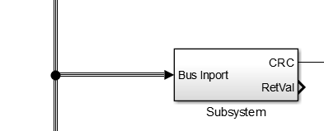
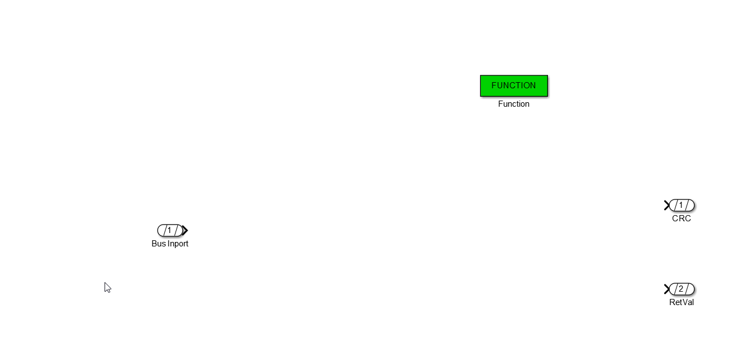
Matlab/Targetlink
Create Subsystem
Input:
Read message structure from the input Port
Output:
Calculated CRC, type uint8
Std_ReturnType, set if execution was correct or not

Slide 4
Matlab/Targetlink
Add Targetlink function block

Slide 5
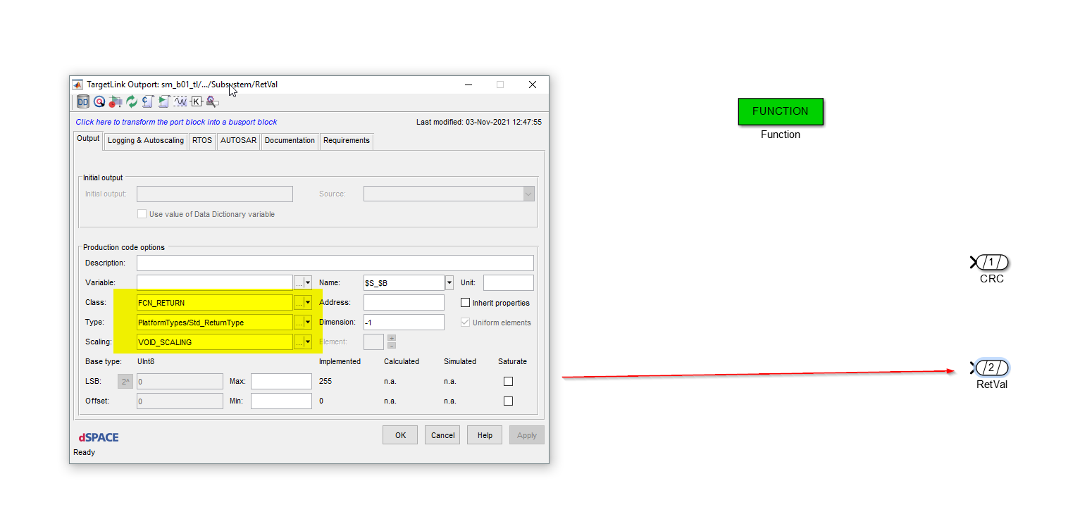
Matlab/Targetlink
Configuration of RetVal:

Slide 6
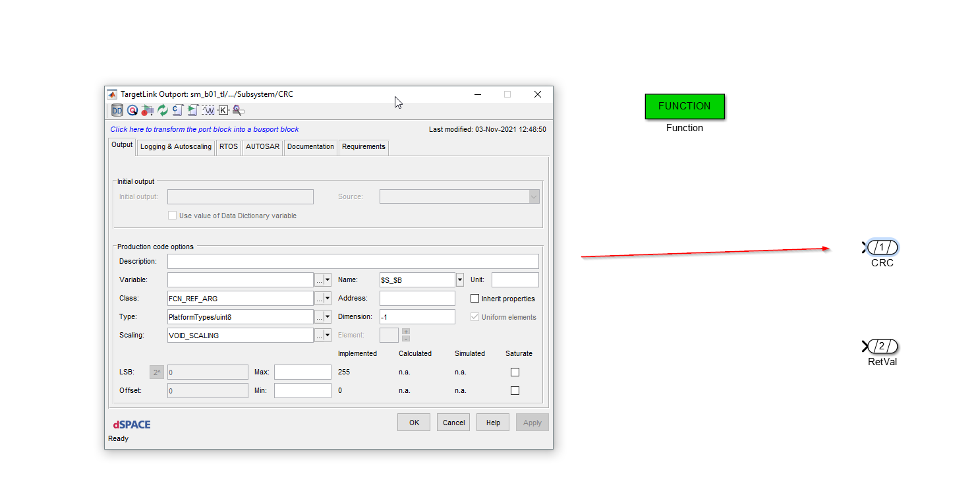
Matlab/Targetlink
Configuration of CRC parameter

Slide 7
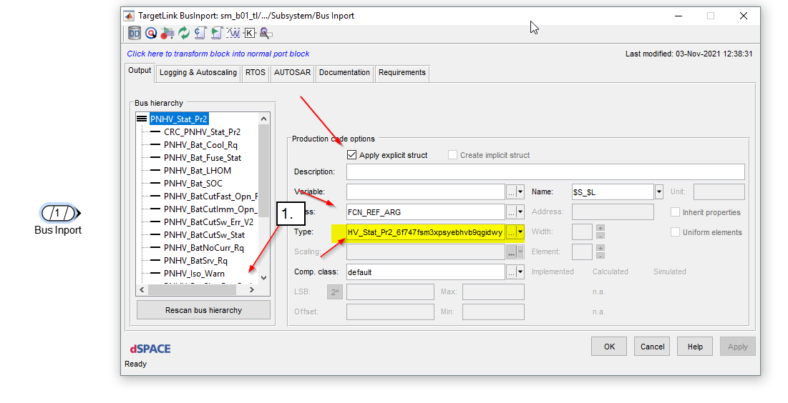
Matlab/Targetlink
Configuration of Input parameter:
1. Click Rescan bus hierarchy
Type: Check if the correct type is used

Slide 8
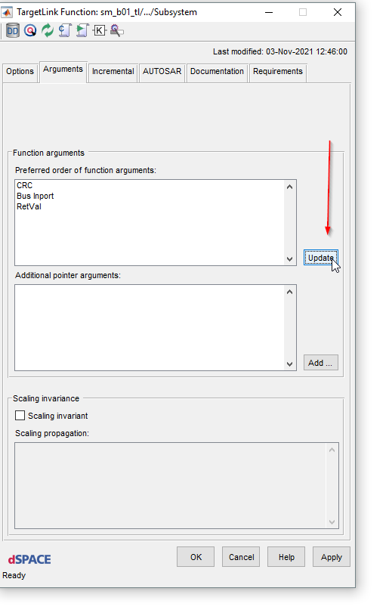
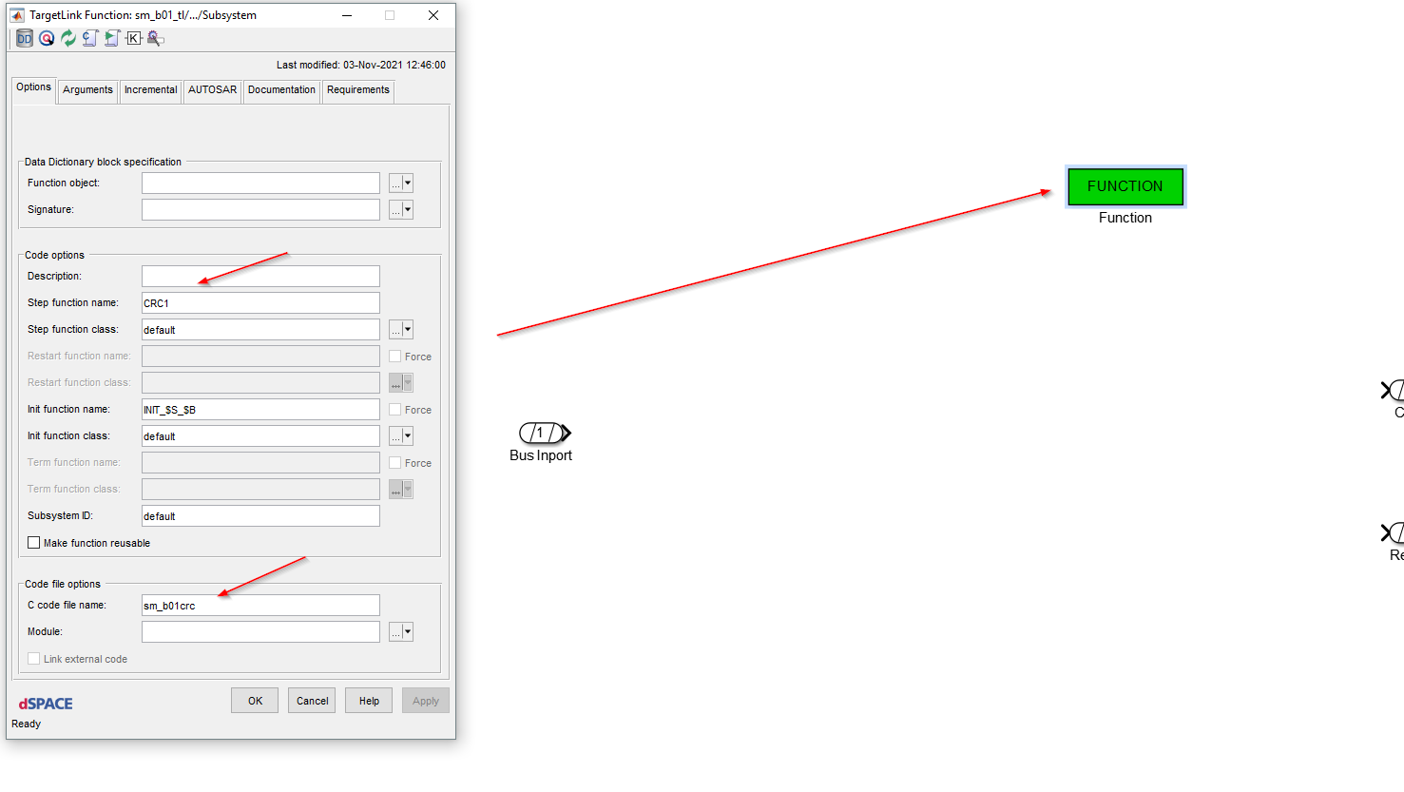
Matlab/Targetlink
Function Block configuration:
Please check next slide for name definition

Slide 9
Matlab/Targetlink
Step function name
mg_tCalcCRC[MESSAGENAME]
C code file name
intcanhl_asil_calccrc

Slide 10
After generation
After targelink generation you should see two additional files
intcanhl_asil_calccrc.c and intcanhl_asil_calccrc.h
Copy them to the SWC folder
Add to build environment
Merge the files if they already existed
Now the needed implementation for the CRC calculation can be peformed

Slide 11
C-File Adaption
Include the provided file intcanhl_asil_crc.h
Add function implementation mg_tCalcCRC[MESSAGENAME]
Check if inputs are corrrect, e.g. Null Pointer
Use return value to set errors
Create array
Calculate CRC, call CRC calculation function
See intcanhl_asil_crc.h
Return calculated CRC in CRC output parameter

Slide 12
Smarter. Greener. Together.

